Slide 1


CHEF PRESENTATION
Rohit Kohli

Slide 2
Introduction To Chef
Chef is an automation tool that provides a way to define infrastructure as code. Infrastructure as code (IAC) simply means that managing infrastructure by writing code (Automating infrastructure) rather than using manual processes.
This technology uses Ruby encoding to develop basic building blocks like recipe and cookbooks
It is used to streamline the task of configuration and managing the company’s server
FEATURES OF CHEF
Chef uses popular Ruby language to create a domain-specific language.
Chef is ideal for deploying and managing the cloud server, storage, and software.

Slide 3
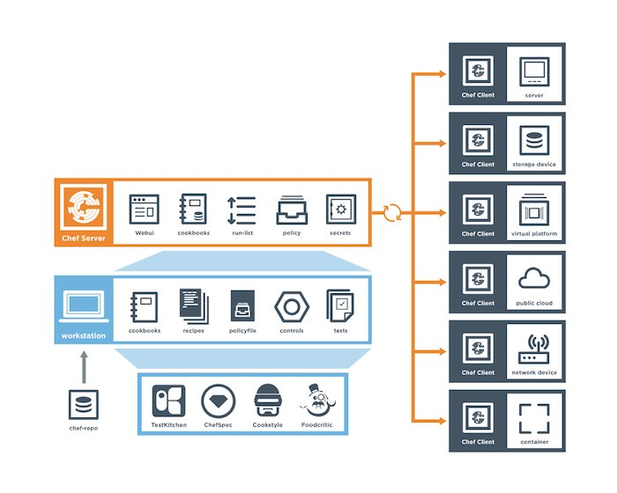
Architecture of Chef
Chef Has three main components :
Workstation : The location where users interact with Chef Infra
Server : It acts as hub which stores cookbooks, the policies that are applied to nodes, and metadata that describes each registered node that is being managed by Chef
Nodes : are the machines that are managed by Chef Infra and on which all configurations are applied

Slide 4
Building Blocks Of Chef
Recipe : It can be defined as a collection of attributes which are used to manage the infrastructure
Cookbook : A cookbook is a collection of recipes. They are the basic building blocks which get uploaded to Chef server
Resource : It is the basic component of a recipe used to manage the infrastructure with different kind of states eg package, service, user, group, file etc
Attribute : They can be thought of as a key value pair of anything which one wants to use in the cookbook. There are several different kinds of attributes that can be applied
Template : Template files end with the .erb extension, which means they contain embedded Ruby
Metadata : It is used to manage the metadata about the package. This includes details like the name and details of the package

Slide 5
Chef Assignment
Mongodb Configuration : Translate Mongo DB installation instruction from install.rb into chef code
Tomcat Configuration : Translate the tomcat installation instruction from Instruction.rb into chef code
Windows ChefSpec : Use the Chef Resources and Chef Inspec to configure Windows security benchmark
Bonus Topic : To configure Awesome Application Repair and Middleman
Kindly refer : https://github.com/chef-cft/workshops for more details on assignment

Slide 6
Mongo DB Configuration
Instructions Provided :
Translate the MongoDB installation instruction from install.rb into chef code
Use the chef resource to find the most appropriate chef resource to use for each task
Once the criteria are met, send a link in github
Provide the instructions to execute code

Slide 7
Mongo DB Configuration
The configuration is achieved using Chef Automation.
Various components involved in it :
Chef : It is used as an automation tool to define infrastructure as code
AWS : It is involved as to spin up the ec2 machine for Kitchen testing (awslinux-2.0 )
Chef Building Blocks : attributes, recipes, spec, metadata, policyfile

Slide 8
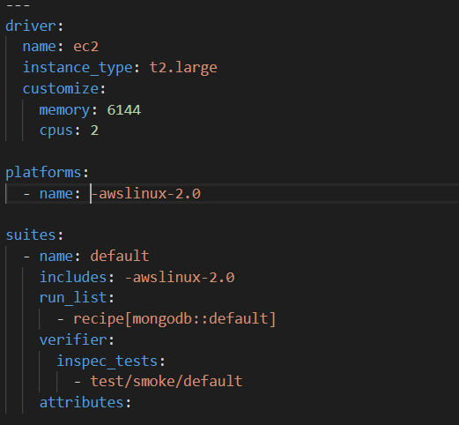
Mongo DB Configuration Steps
Step 1) Write the configuration for .kitchen.ec2.yml ( Sample Below )
Step 2) Run Kitchen create to create your instance and .kitchen.yml will be generated

Slide 9
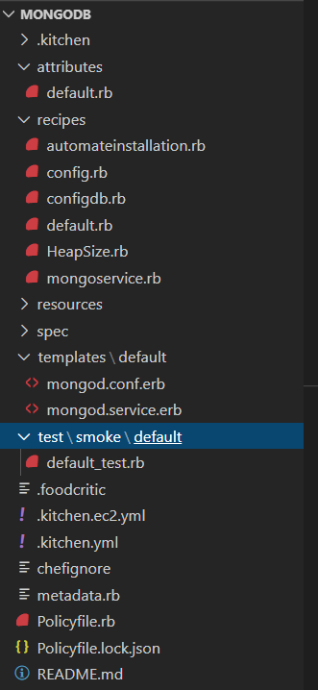
Mongo DB Configuration Steps Contd..
Step 3) Write the recipes for configuration with various resources and attributes ( Sample Below )

Slide 10
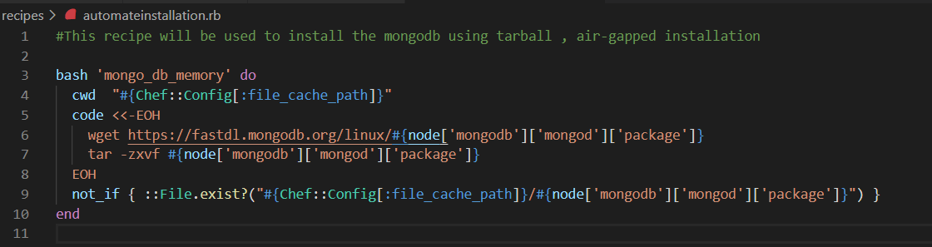
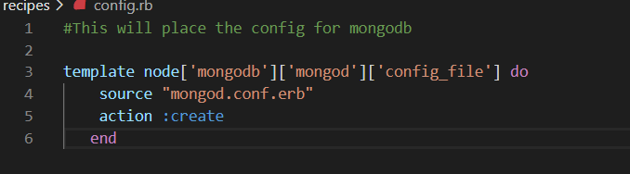
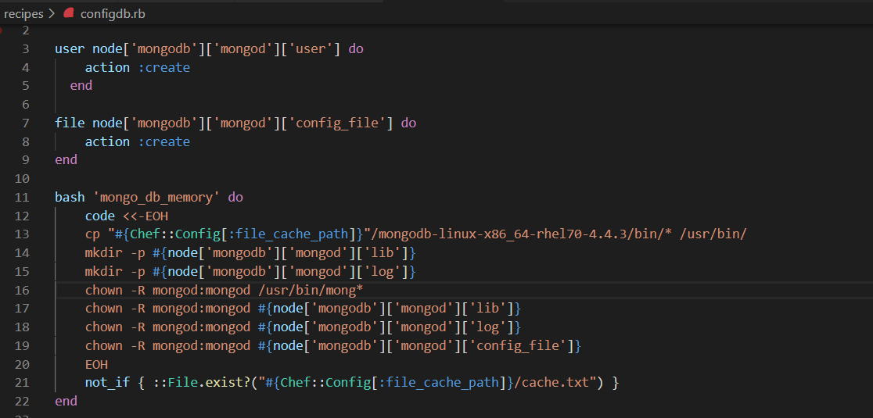
Mongo DB Configuration Steps Contd..
Step 3) Recipes and attributes involved for configuring MongoDB

Slide 11
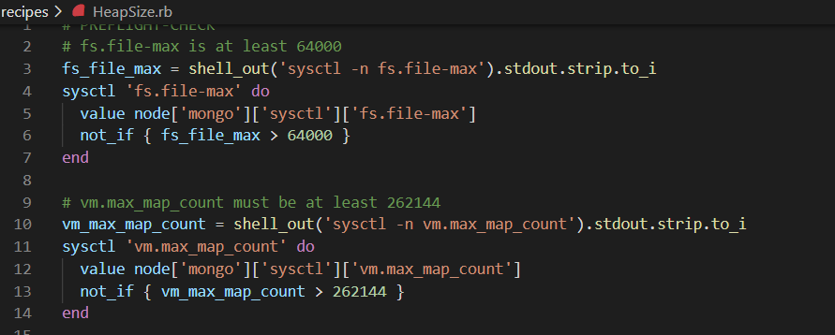
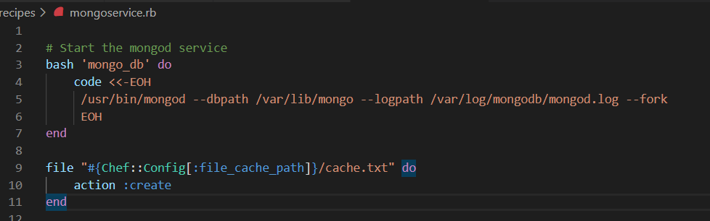
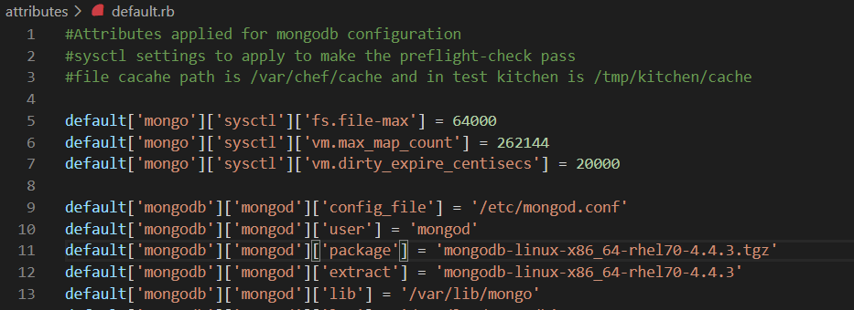
Mongo DB Configuration Steps Contd..
Step 3) Recipes and attributes involved for configuring MongoDB

Slide 12
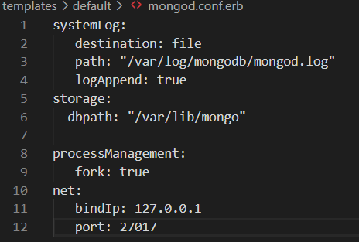
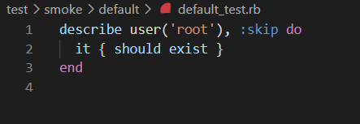
Mongo DB Configuration Steps Contd..
Step 4) Templates Involved for Mongo DB configuration and sample test case to execute
Step 5) After the cookbook is ready for execution, run Kitchen converge and after converge “Kitchen login”
Step 6) Basic Test : run “mongod” to log into db and “use database_name” to create new db. If these two passes, then goal is achieved.

Slide 13
Tomcat Configuration
Instructions Provided :
Translate the Tomcat installation instruction from instruction.rb into chef code
Use the chef resource to find the most appropriate chef resource to use for each task
Once the criteria is met, send a link in github
Provide the instructions to execute code

Slide 14
Tomcat Configuration
The configuration is achieved using Chef Automation.
Various components involved in it :
Chef : It is used as an automation tool to define infrastructure as code
AWS : It is involved as to spin up the ec2 machine for Kitchen testing (awslinux-2.0)
Chef Building Blocks : attributes, recipes, spec, metadata, policyfile

Slide 15
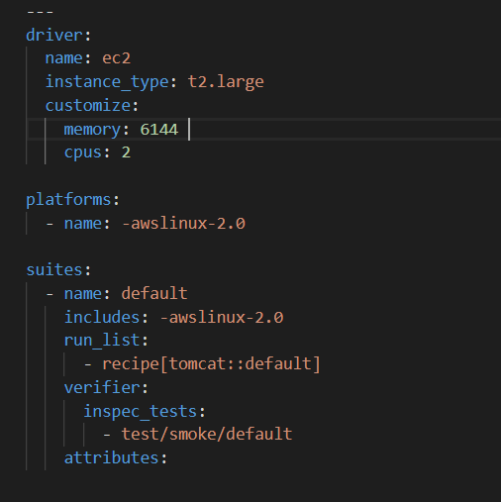
Tomcat Configuration Steps
Step 1) Write the configuration for .kitchen.ec2.yml ( Sample Below )
Step 2) Run Kitchen create to create your instance and .kitchen.yml will be generated

Slide 16
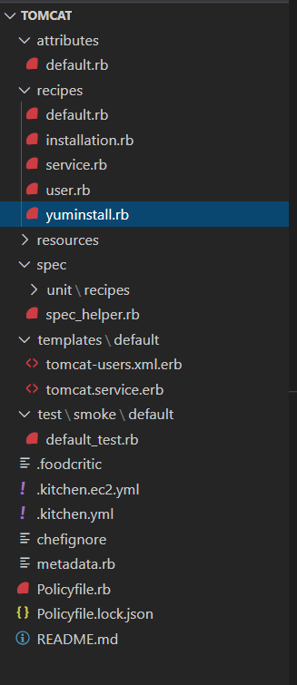
Tomcat Configuration Steps Contd..
Step 3) Write the recipes for configuration with various resources and attributes ( Sample Below )

Slide 17
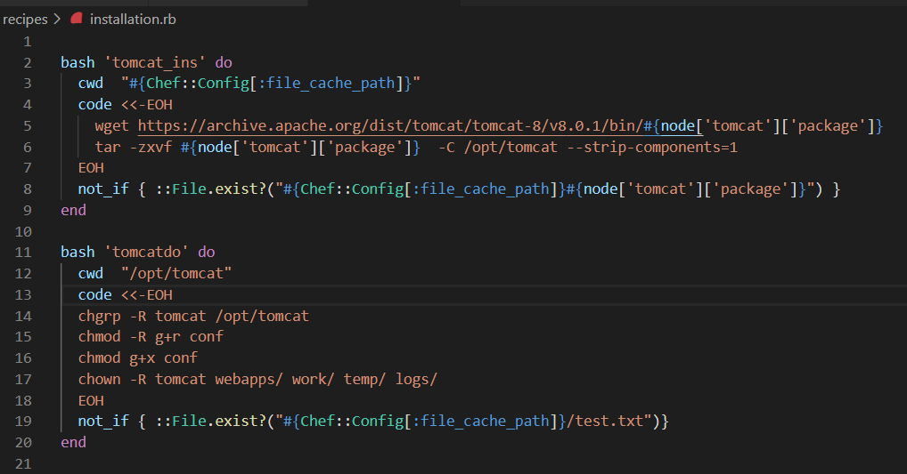
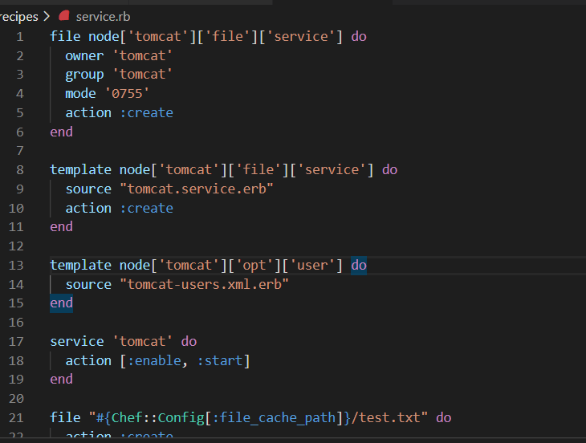
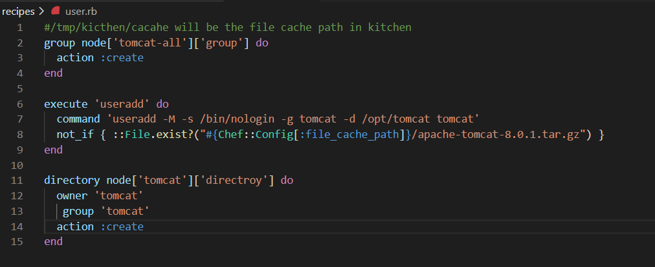
Tomcat Configuration Steps Contd..
Step 3) Recipes and attributes involved for configuring Tomcat

Slide 18
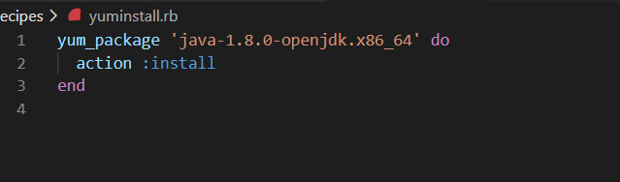
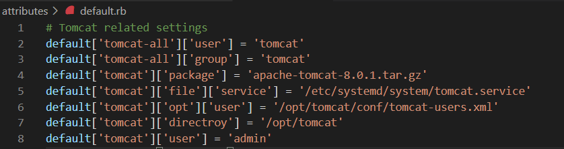
Tomcat Configuration Steps Contd..
Step 3) Recipes and attributes involved for configuring Tomcat

Slide 19
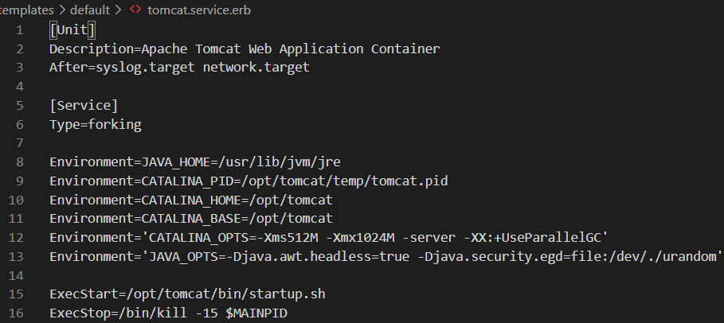
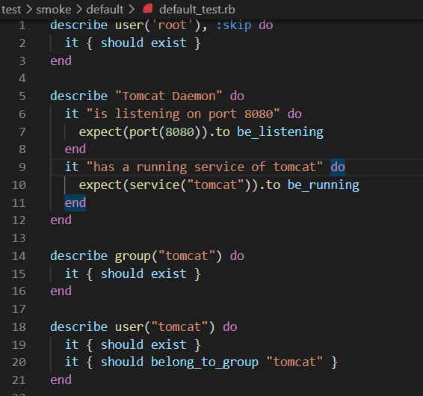
Tomcat Configuration Steps Contd..
Step 4) Templates Involved for Tomcat configuration and sample test case to execute
Step 5) After the cookbook is ready for execution, run Kitchen converge and after converge “Kitchen login”
Step 6) Basic Test : run “curl http://localhost:8080 “ and if you get output, then configuration is success. Also you can login to webpage that too is handled as part of recipe

Slide 20
Windows Server Benchmark Configuration
Instructions Provided :
Use the chef resource to find the most appropriate chef resource to use for each task
Use Chef Inspec resources for meeting the benchmark standards
Once the criteria is met, send a link in github
Provide the instructions to execute code

Slide 21
Windows Server Benchmark Configuration
The configuration is achieved using Chef Automation.
Various components involved in it :
Chef : It is used as an automation tool to define infrastructure as code
AWS : It is involved as to spin up the ec2 machine for Kitchen testing (aws-windows-2016-base)
Chef Building Blocks : attributes, recipes, spec, metadata, policyfile

Slide 22
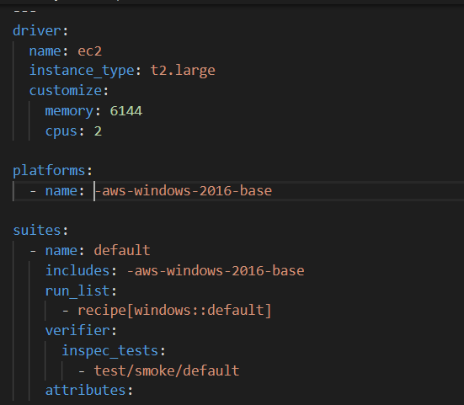
Windows Server Benchmark Configuration
Step 1) Write the configuration for .kitchen.ec2.yml ( Sample Below )
Step 2) Run Kitchen create to create your instance and .kitchen.yml will be generated

Slide 23
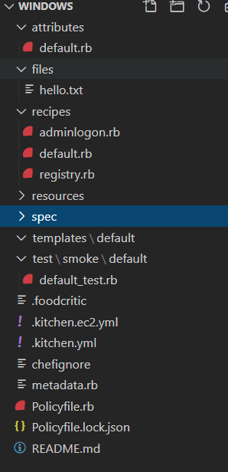
Windows Server Benchmark Configuration Contd..
Step 3) Write the recipes for configuration with various resources and attributes ( Sample Below )

Slide 24
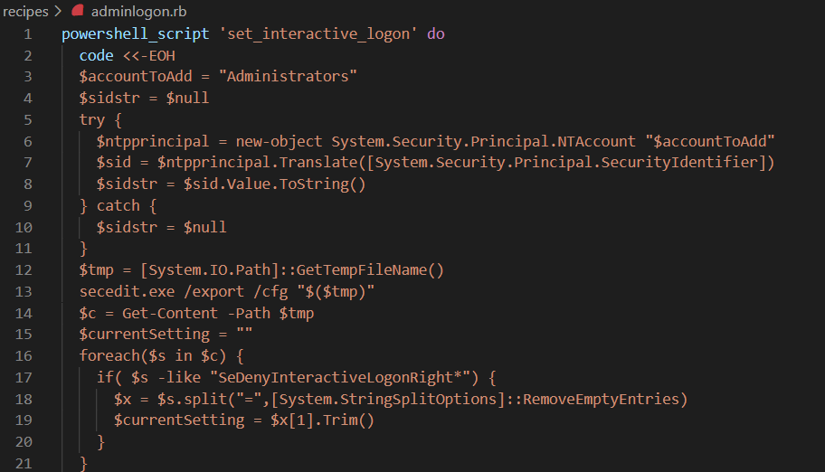
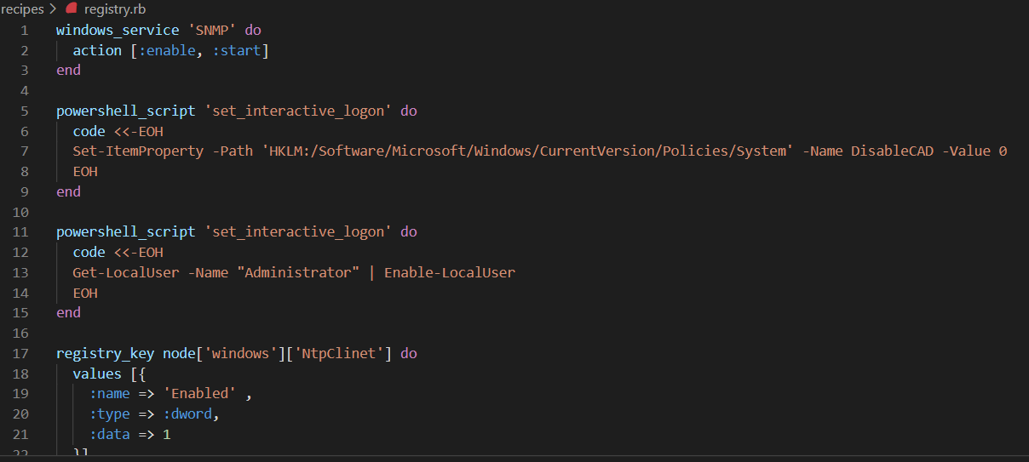
Windows Server Benchmark Configuration Contd..
Step 3) Recipes and attributes involved for configuring windows

Slide 25
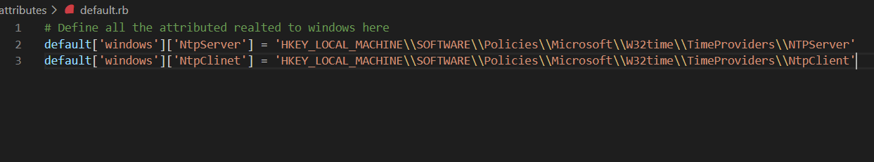
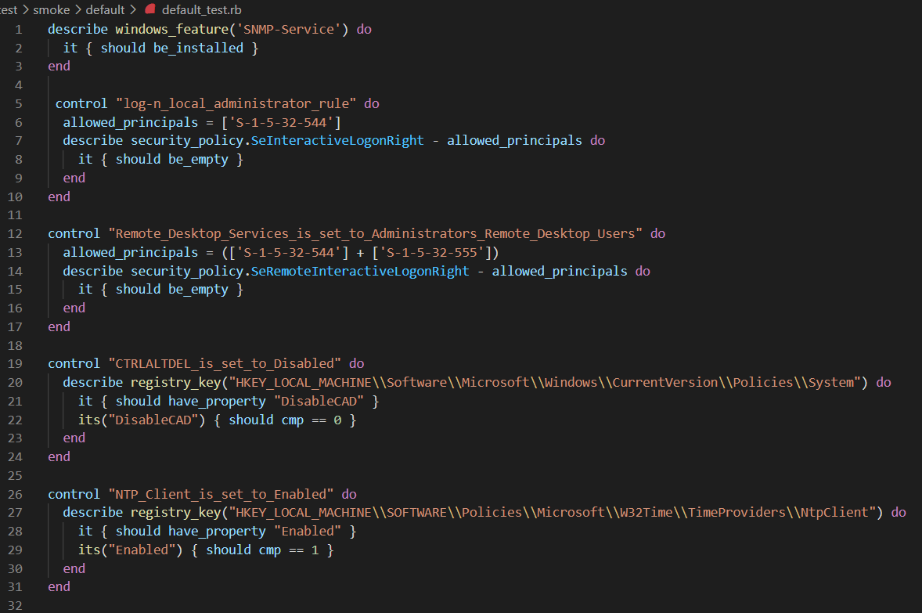
Windows Server Benchmark Configuration Contd..
Step 3) Attributes and test cases involved for configuring Windows server

Slide 26
Windows Server Benchmark Configuration Contd..
Step 4) After all the recipe and resources in place now run converge for window
Step 5) With the recipes in place, the new windows server will be created as per benchmark
Step 6) To verify the benchmark now execute the inspec test against it with “Kitchen Verify”
Step 7) The default path of test is defined as /test/smoke/default/default_test.rb. This path can be changed accordingly
Step 8) All test cases are passing

Slide 27
Bonus Topics – Middleman and Awesome Application Repair
Instructions Provided :
Translate the Middleman installation instruction.rb into chef code
Awesome application installation instruction.rb into chef code
Use the chef resource to find the most appropriate chef resource to use for each task
Once the criteria is met, send a link in github
Provide the instructions to execute code

Slide 28
Bonus Topics – Middleman and Awesome Application Repair
The configuration is achieved using Chef Automation.
Various components involved in it
Chef : It is used as an automation tool to define infrastructure as code
AWS : It is involved as to spin up the ec2 machine for Kitchen testing (awslinux-2.0)
Chef Building Blocks : attributes, recipes, spec, metadata, policyfile

Slide 29
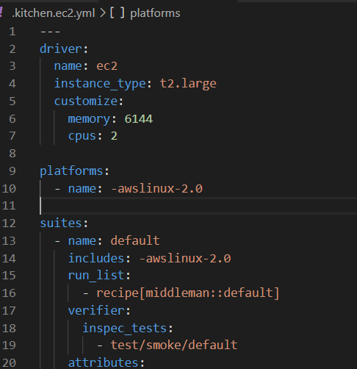
Bonus Topics – Middleman and Awesome Application Repair
Step 1) Write the configuration for .kitchen.ec2.yml ( Sample Below )
Step 2) Run Kitchen create to create your instance and .kitchen.yml will be generated

Slide 30
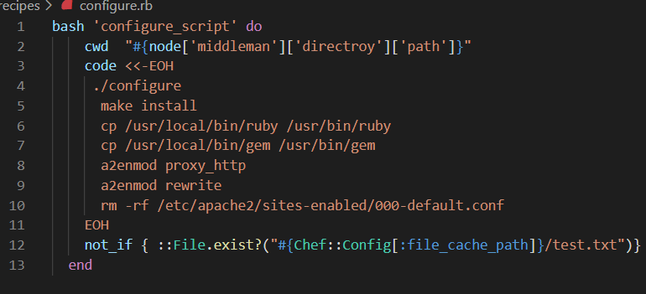
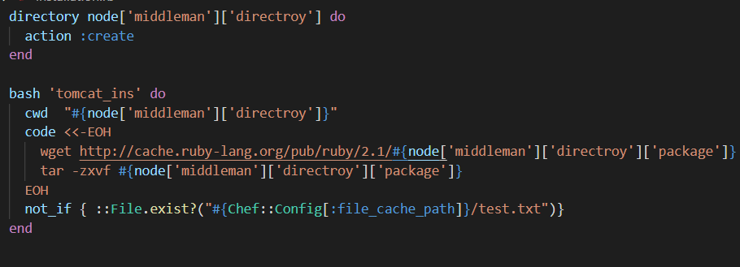
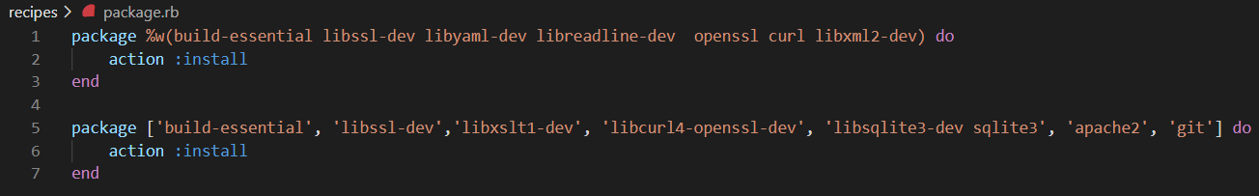
Bonus Topics – Middleman
Step 3) Write the recipes for configuration with various resources and attributes ( Sample Below )

Slide 31
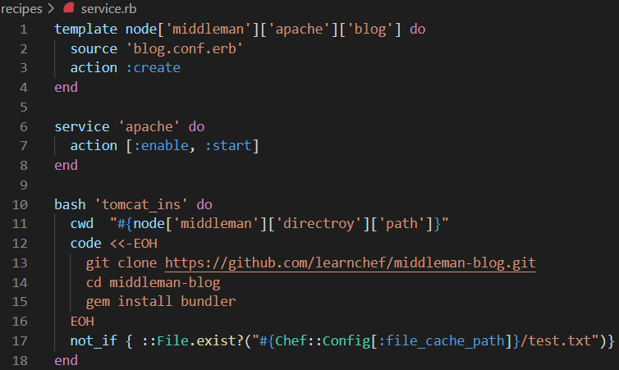
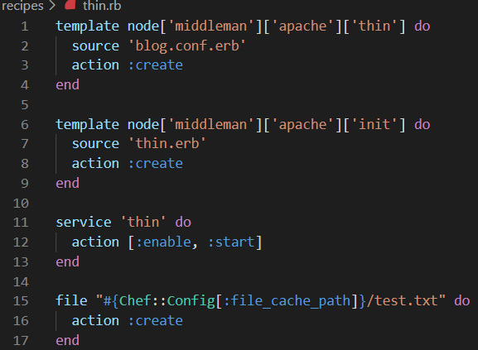
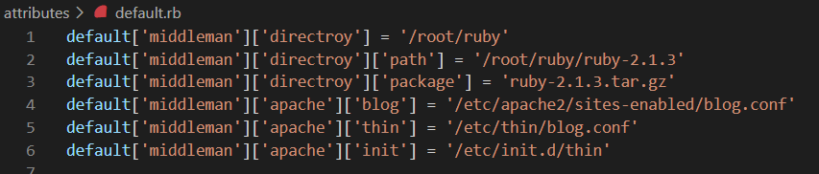
Bonus Topics – Middleman Contd..
Step 3) Write the recipes for configuration with various resources and attributes ( Sample Below )

Slide 32
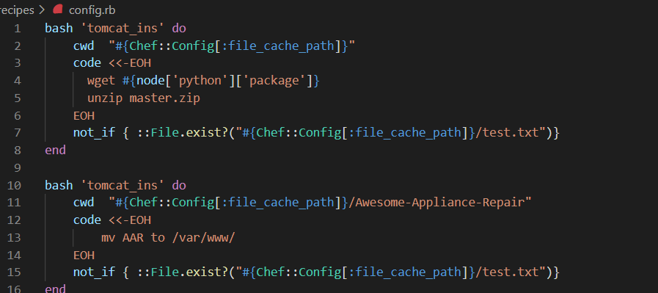
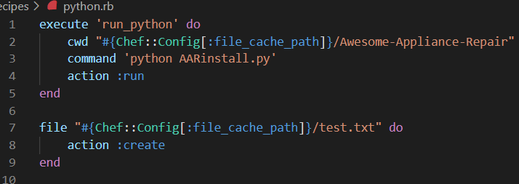
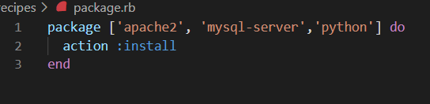
Bonus Topics – Awesome Application Repair
Step 1) Write the recipes for configuration with various resources and attributes ( Sample Below )

Slide 33
Bonus Topics – Middleman and Awesome Application Repair
Mode of testing : These are ubuntu compatible and is not been tested, but code for same is available for reference
It contains the two pieces of work
Middleman recipe and Awesome application repair are written and committed to same branch
Awesome application repair is python based and for same cookbook is available
All the dependencies for both the cookbook are already taken care by recipe

Slide 34


Reference for Assignment
For Code reference please hit GitHub url
https://github.com/rohit14101991/chef-cookbooks
For executing code refer Readme.md
https://github.com/rohit14101991/chef-cookbooks/blob/main/README.md
For Any queries reach out author of cookbook
- Rohit Kohli

Slide 35
Thank you !!!
Please let me know if any queries …
Presented By : Rohit Kohli

